Slide 1
Things I want to eat but cannot
By: me

Slide 2
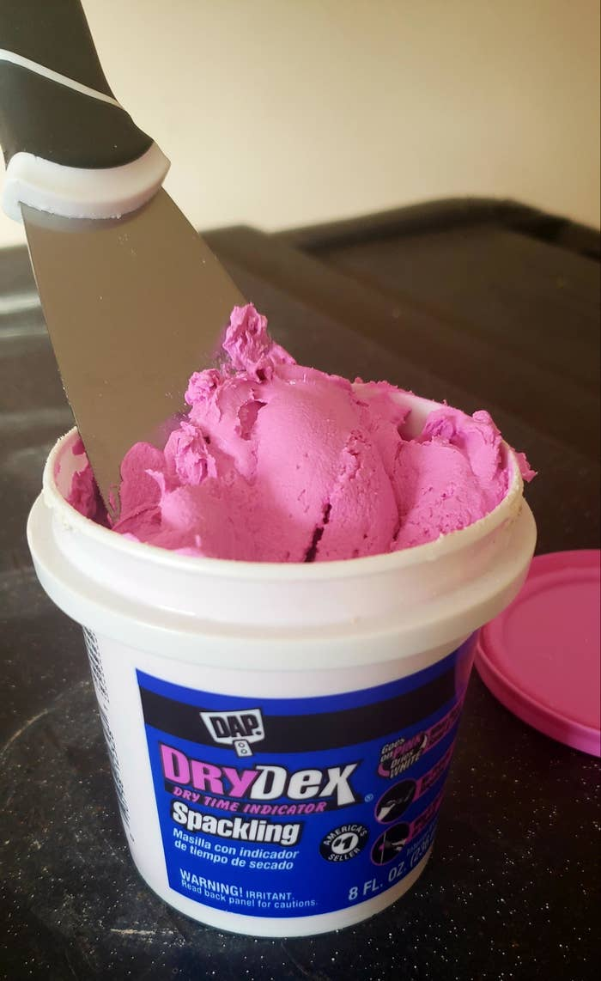
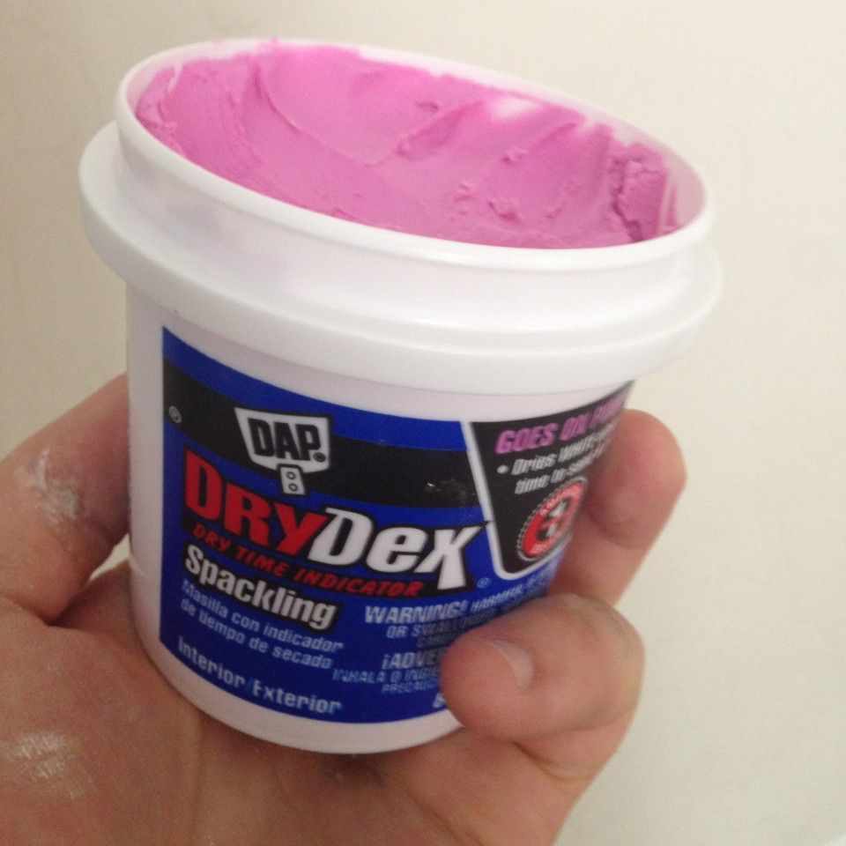
Dry Dex
Used for: covering up holes in the walls (Also known as spackling)
What I want to do with it: eat it
It looks like: pink pudding/ice cream
Overview: 7/10
It’s very soft and bright pink, it’s screaming at me to eat it.

Slide 3
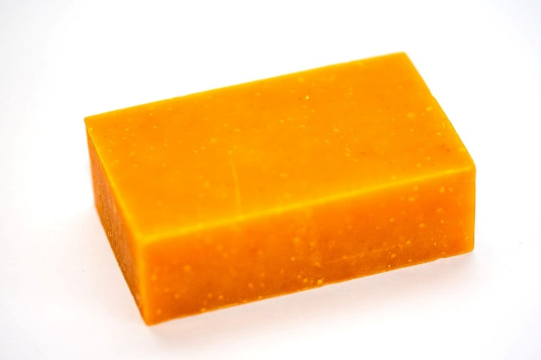
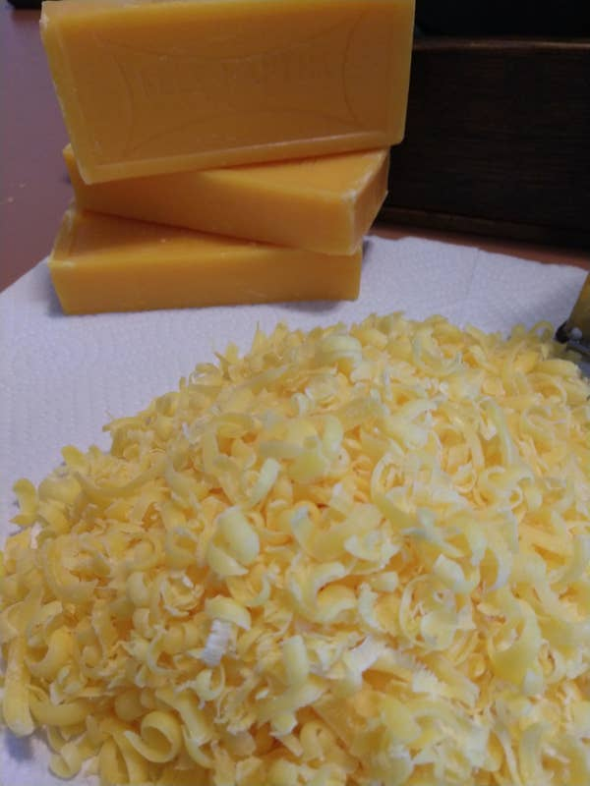
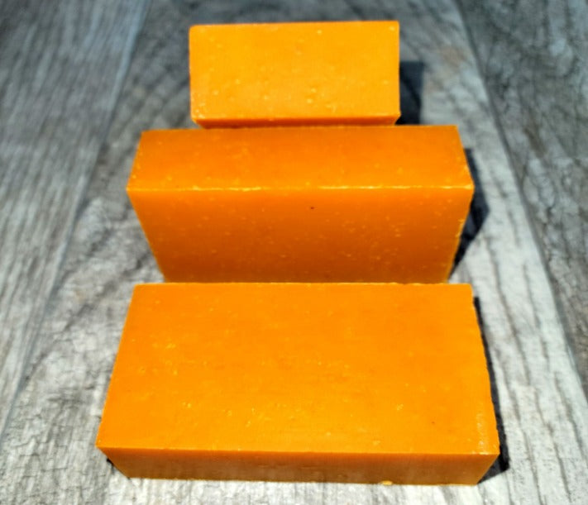
Orange Bar Soap
Used for: washing hands
What I want to do with it: eat it
What it looks like: cheddar cheese
Overview: 8/10
It looks like cheddar cheese and it probably smells super good, I want to give into the intrusive thoughts and eat some.

Slide 4
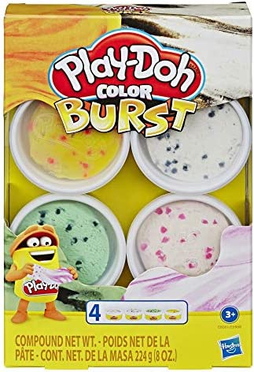
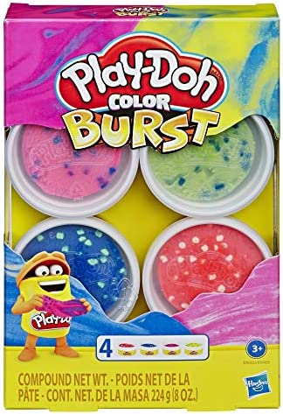
Play-doh ‘Color Burst’
Used for: playing with for kids
What I want to do with it: devour it and put it in the microwave (to see if it will melt like real ice cream)
What it looks like: yummy ice cream
Overview: 6/10
It semi looks like ice cream, and it might also have sugar in it! There might be harmful chemicals in it but I’ll eat it anyways. And the name even sounds good.

Slide 5
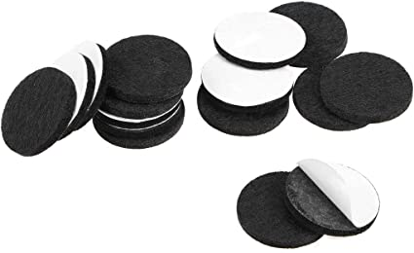
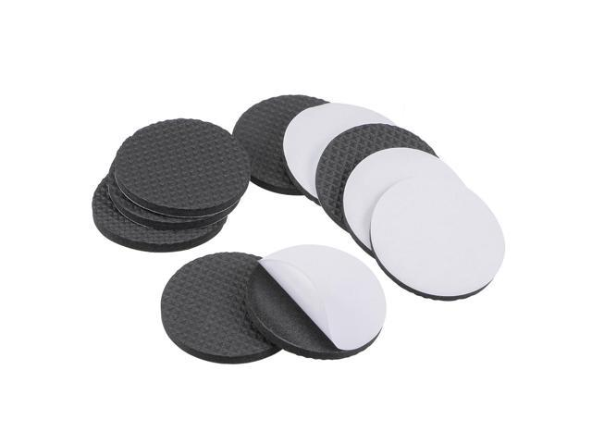
Furniture Grips
Used for: making chairs from making loud noises when there moved
What I want to do with it: peel them apart and eat them
What it looks like: Oreos
Overview: 7/10
They look like Oreos and even have like the same pattern on them. I really don’t care if I get a mouthful of cardboard fluff, I want to eat it.

Slide 6
The end!

