Slide 1
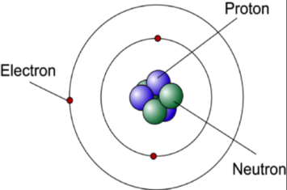
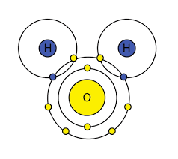
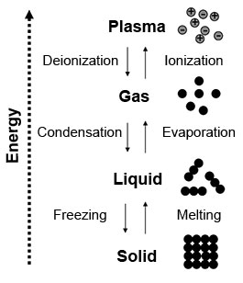
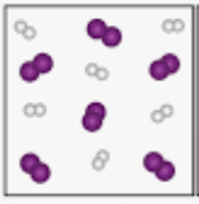


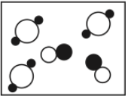


Atoms = The tiniest units of matter! They’re only one element, and they have the properties of chemical elements!
AND
Molecules/Compounds = A duo or an increased number of atoms that hang out together because of cool chemical bonds! While molecules are twin elements or different elements, compounds need multiple elements that aren’t the same!
1. An unexpected change in temperature.
2. Unexpected, permanent color shift.
3. Excretion of gas particles (But not boiling!)
4. Causing precipitation!
5. Becoming a clear source of light.
6. Creating sound waves (Like fireworks!)
7. Smelling different! (Great, now I’m craving cookies.)
8. Taste. (Note to self; don’t lick bleach. Tastes bad.)
make up all
Plasma
MATTER
Gas
How you know it’s a chemical reaction:
Liquid
The 4 phases of matter!
(which has Volume and Mass!)
and exists as...
Solid.
Pure substances are composed of the exact same types of atoms or molecules, and they’re all chemically bonded and separated!
OR
Mixtures are the exact opposite of Pure Substances, being different elements/compounds that are Physically combined. They can be separated, but you must be skilled to do that since it’s a bit tricky sometimes. It’s like colored water, or washable markers!
which can be
Compounds are atoms of many different elements with a set composition and ratio, and Molecules are similar, but the elements don’t have to be different!
which can be
Elements are made of only one type of atom, but an extreme amount of them! It’s crazy to think about it, but they can’t be broken down into anything else!
OR
OR
Heterogeneous mixtures, the opposite of Homogeneous mixtures, aren’t the same throughout their entire form. Oil and water, you know?
Homogeneous mixtures are the same in appearance through its form. It’s like saltwater, which does NOT taste good. Don’t ask how I know.

